Slide 1
Polynomial Regression Model Lab

Slide 2
Example 1:
The Load Data set contains the historical daily average electricity load in megawatts (MW) of southern New Jersey over 20 years from 01/04/1993 to 12/31/2012.

Slide 3
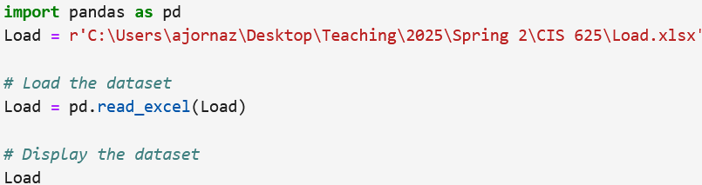
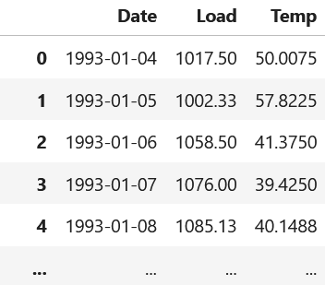
Import the dataset, and print out.

Slide 4

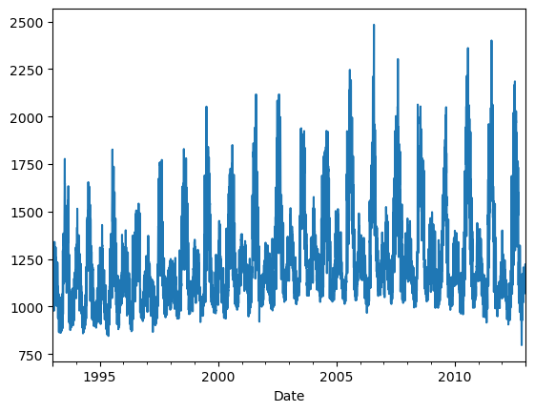
Figure 1 Time series of the load
Plot the load over time (time series of load).

Slide 5

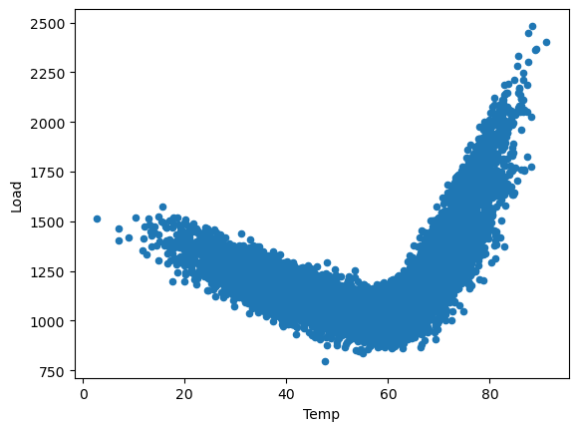
Figure 2 The scatterplot matrix of the load vs. temperature
Using a scatterplot, determine the relationship between the Load and temperature.
There is a strong non-linear relationship between the load and temperature.

Slide 6
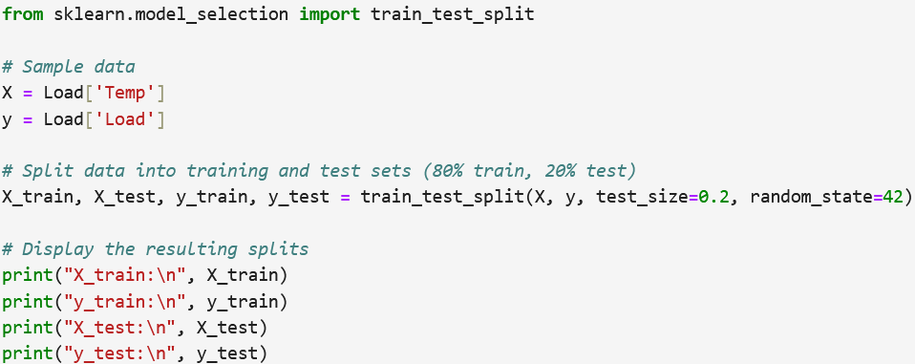
Split the dataset into training (80%) and test (20%) subset.

Slide 7

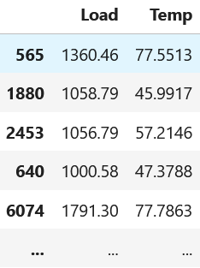
Combine the training subsets into a dataframe.

Slide 8
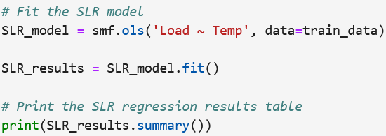
Fit a simple regression model for electricity load.

Slide 9
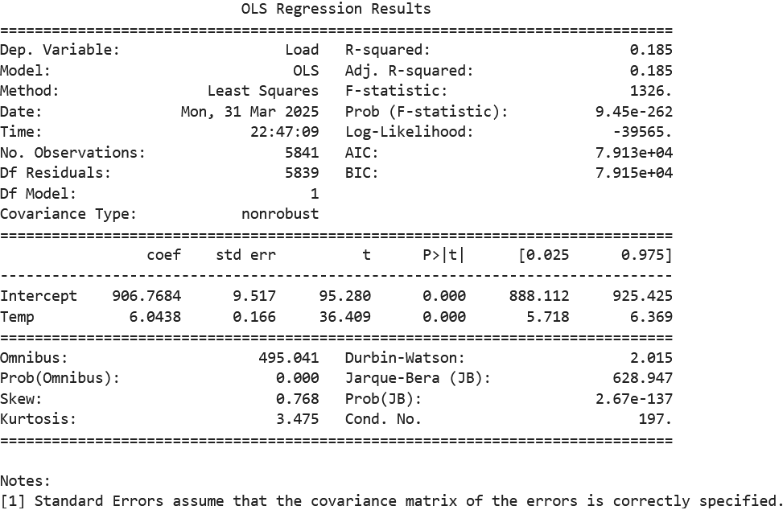
Table 1 The simple linear regression analysis results

Slide 10
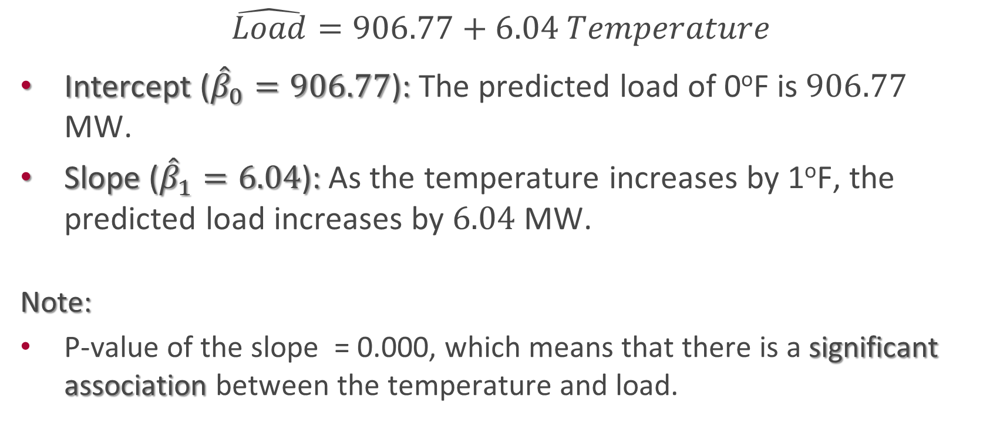
Interpret the regression model coefficients.
$$\hat{Load}=906.77+6.04 Temperature$$
Intercept (${\hat{β}}_{0}=906.77$): The predicted load of 0ºF is $906.77$ MW.
Slope (${\hat{β}}_{1}=6.04$): As the temperature increases by 1ºF, the predicted load increases by $6.04$ MW.
Note:
P-value of the slope = 0.000, which means that there is a significant association between the temperature and load.

Slide 11

Plot the best-fit line (regression line).

Slide 12
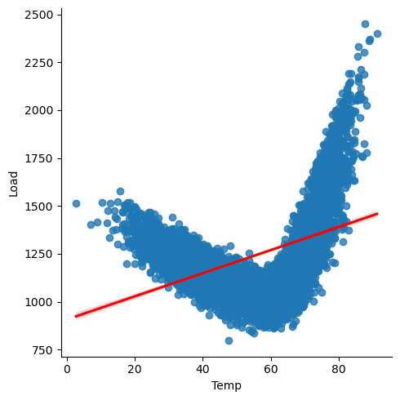
Figure 3 The best-fit line

Slide 13
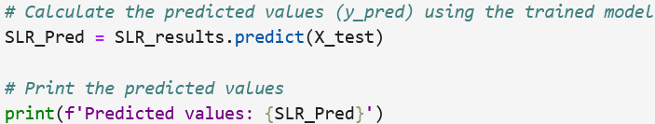
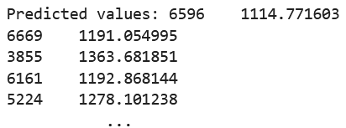
Calculate the predicted values using the test subset.

Slide 14
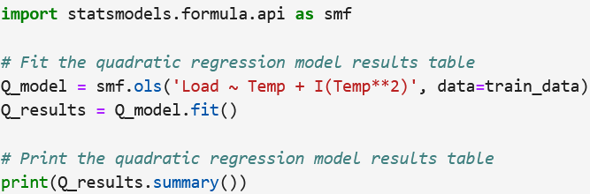
Fit a quadratic regression model (polynomial regression model of the second degree).

Slide 15
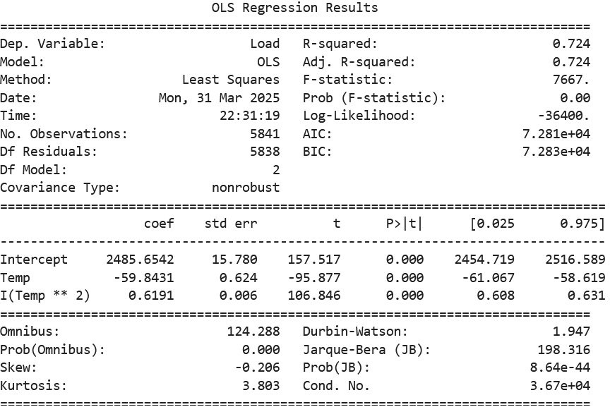
Table 2 The quadratic regression analysis results

Slide 16
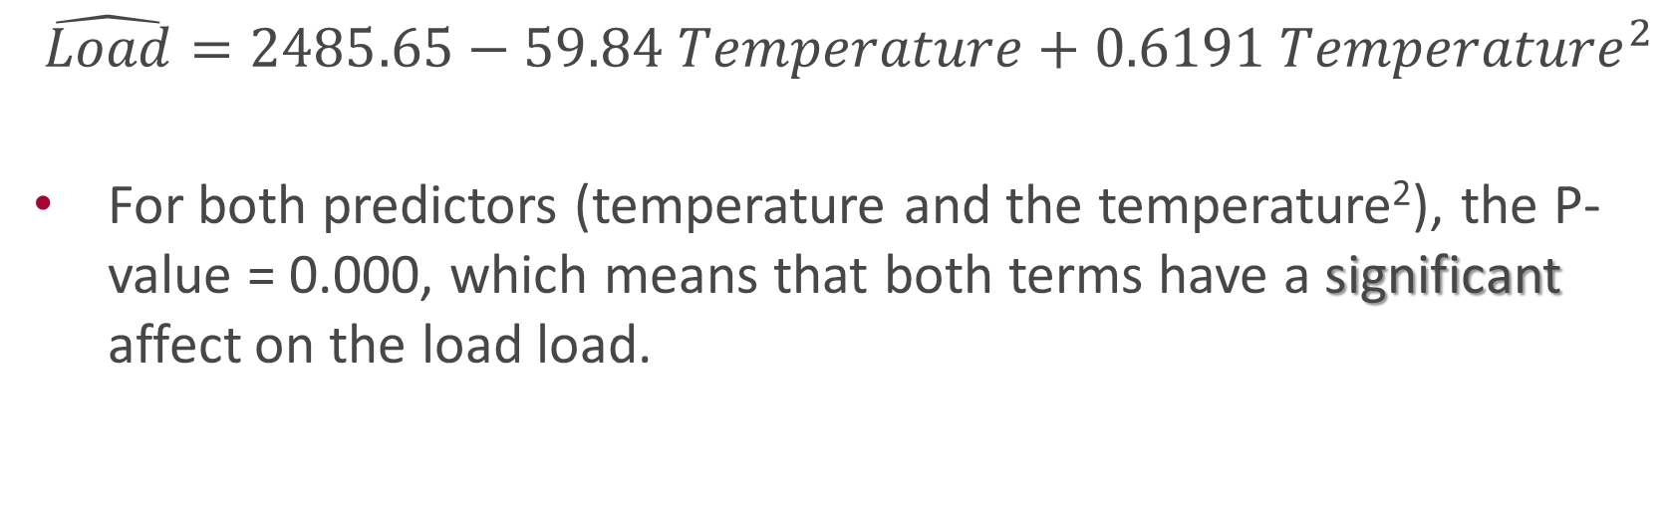
$$\hat{Load}=2485.65−59.84 Temperature+0.6191 {Temperature}^{2}$$
For both predictors (temperature and the temperature²), the P-value = 0.000, which means that both terms have a significant affect on the load load.

Slide 17

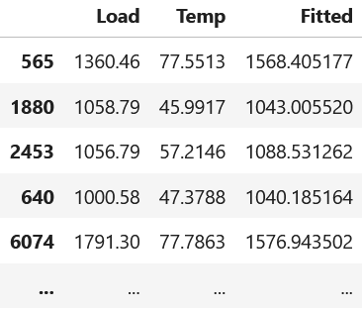
Combine the fitted values with the training data.

Slide 18
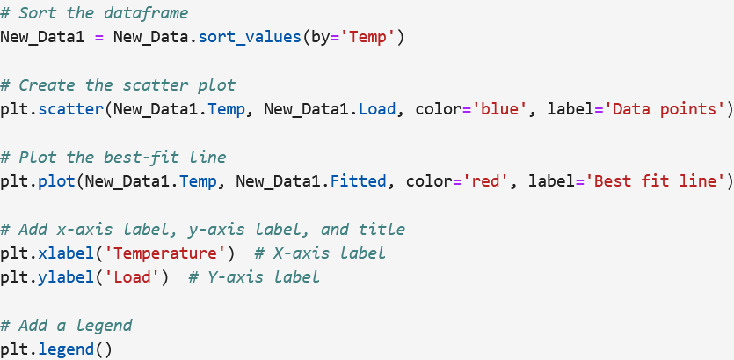
Sort the new data, then plot the best-fit line.
We need sort the data, so fitted values can be connected the order.

Slide 19
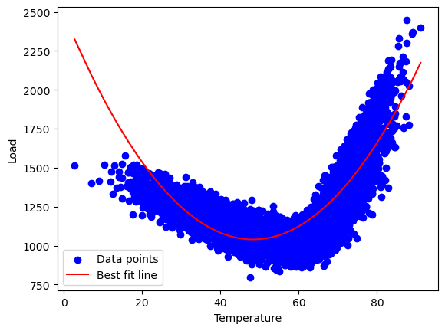
Figure 4 The best-fit line of the quadratic model

Slide 20
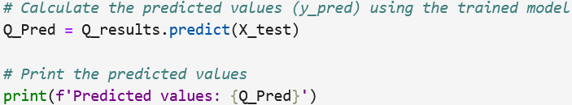
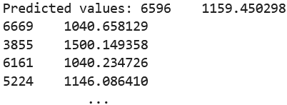
Calculate the predicted values using the test subset.

Slide 21
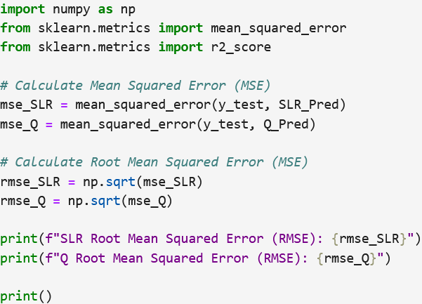
Which model fits the data best? (Evaluate the models)

Slide 22
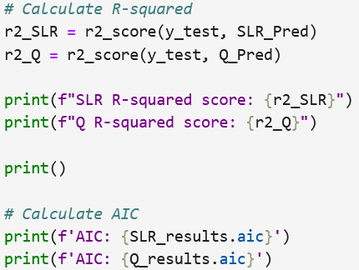
Which model fits the data best? (Evaluate the models)

Slide 23
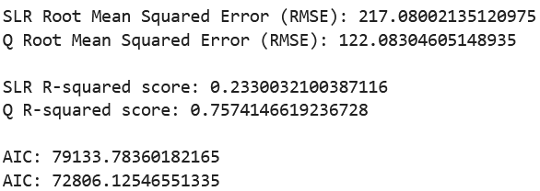
The quadratic regression model fits the data better because it has the lowest RMSE and AIC, and highest R².

